Slide 1
SOFTWARE CRACKING
BY ANKIT RAJ

Slide 2
FLOW OF PRESENTATION
OBJECTIVE OF PRESENTATION
What and Why Software Cracking.
DEMONSTRATION
Computer Architecture & Working of CPU & Memory Subsystem.
Tools and Requirements of demonstration.
Procedure of Software Cracking.
CONTRIBUTION AND IMPACTS
How Software Cracking contributed to people’s life and its impact in long run.

Slide 3
OBJECTIVE OF PRESENTATION
What is Software Cracking?
Manipulation the software codes in such a way it was not intended to work as.
Modification of software to enable disabled features.
Such as disabling copy protection features
Or disabling requirements of serial number.
Why Software Cracking?
Helps to use a paid software for free.
May have encountered the need of a paid software.
But don’t want to spend a penny.
Point is what can we do at zero cost.
Answer is Software Cracking.
Either we can download the cracked software.
Or, we can crack a software by our-self.

Slide 4
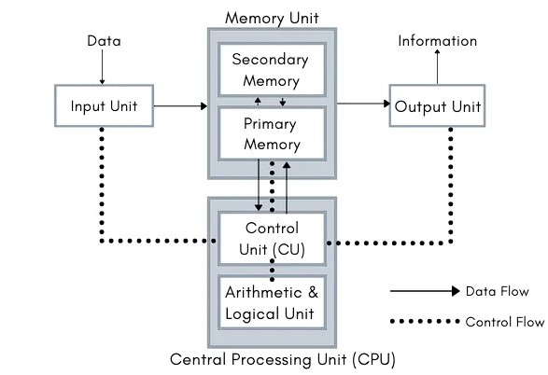
DEMONSTRATION
Computer Architecture & Working of CPU & Memory Subsystem.

Slide 5
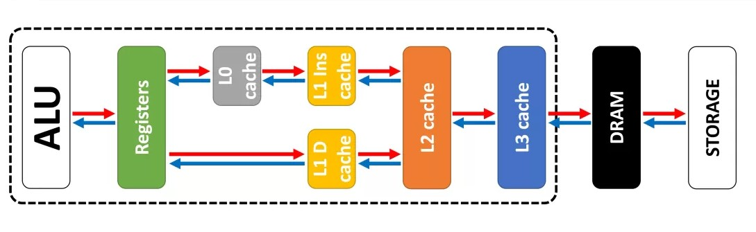
CPU and Memory Subsystem Working

Slide 6
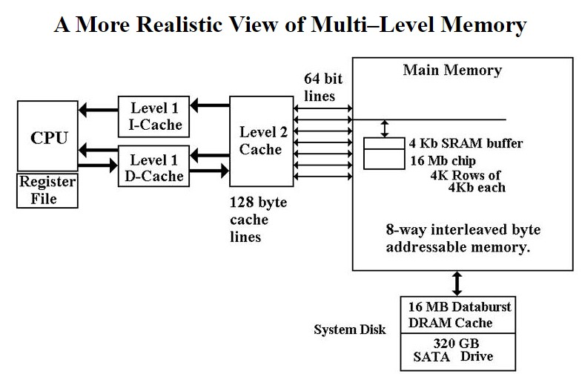

Slide 7
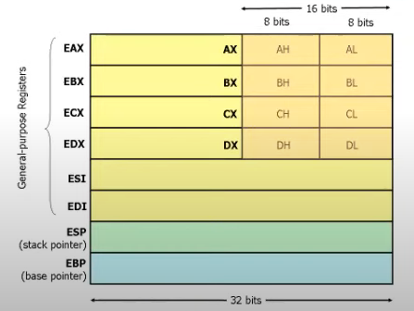
Various x86 Registers

Slide 8
Tools & Requirements:-
1. A Software which needs to cracked - We will be using crackme software.
2. A Disassembler tool – We will be using Olly Debugger.
3. Foundational knowledge on working of CPU.
4. Knowledge of X86 assembly language.

Slide 9
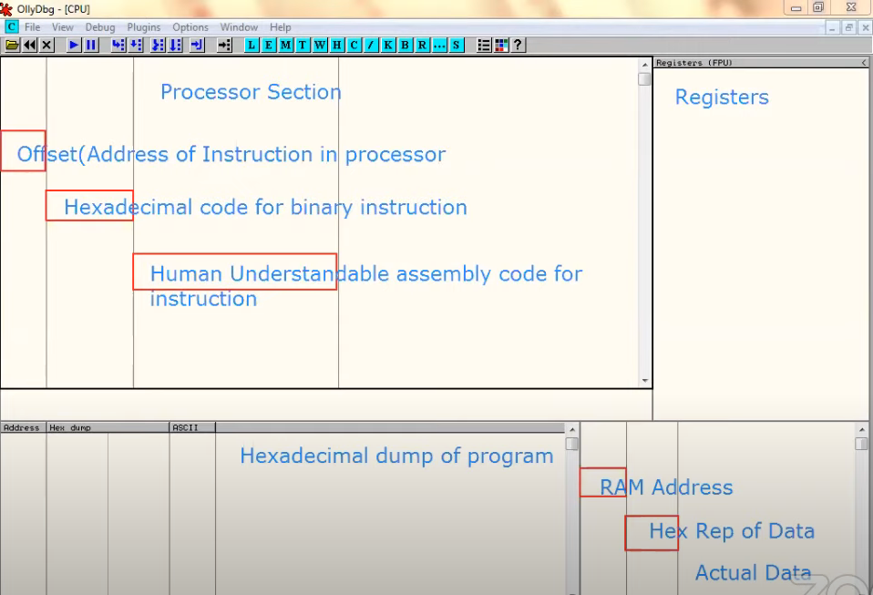
Procedure
Fig - Olly Debugger Interface Description

Slide 10
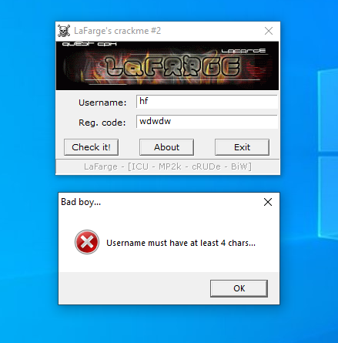
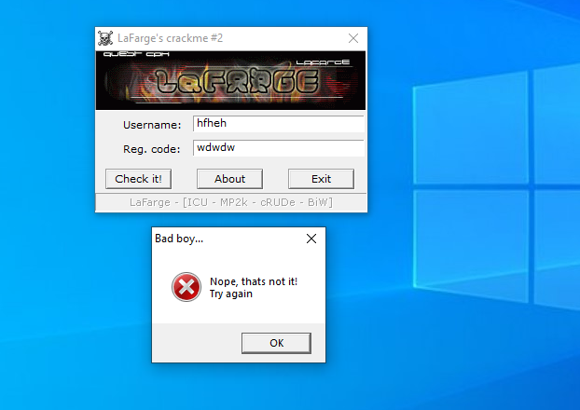
Encountered Errors that needs to be Bypassed.

Slide 11
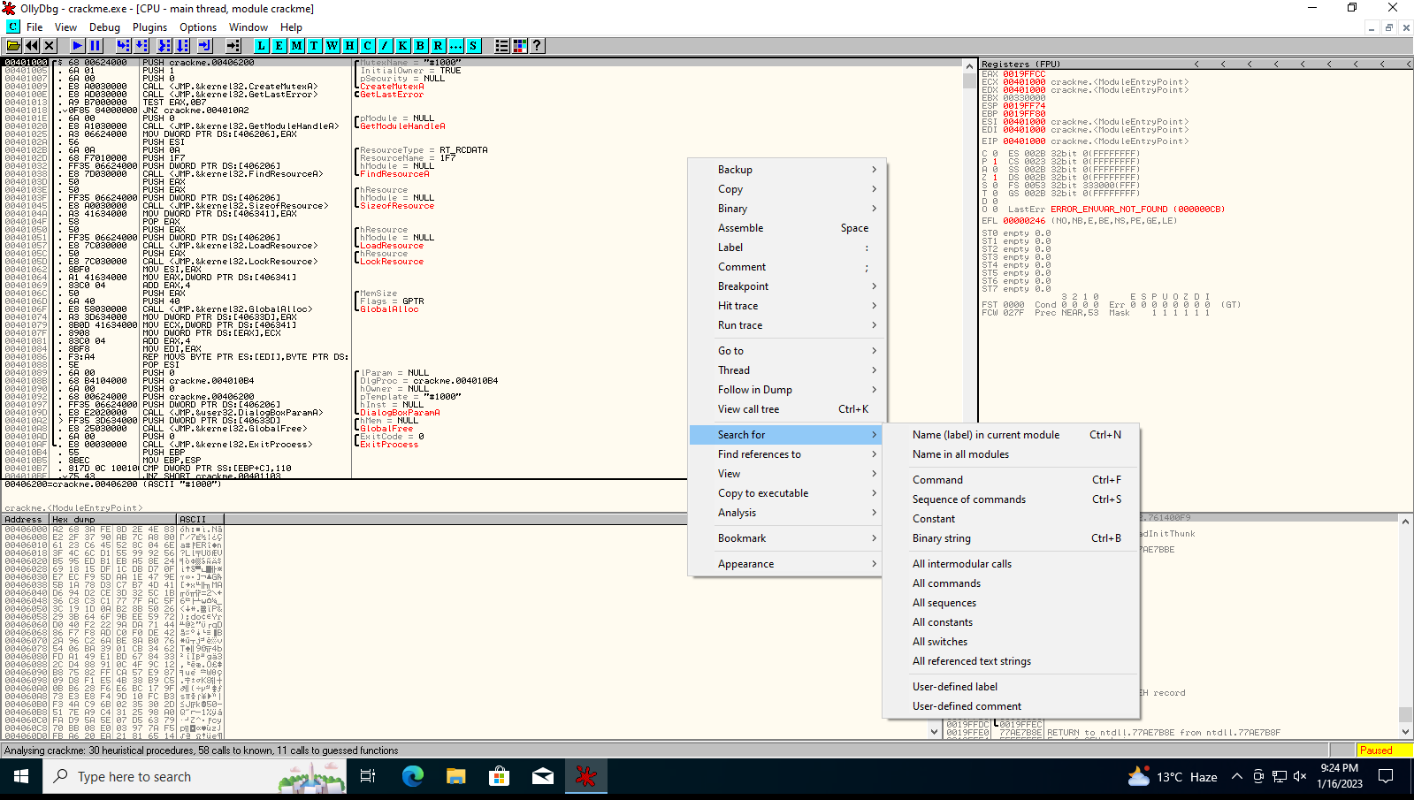

Slide 12
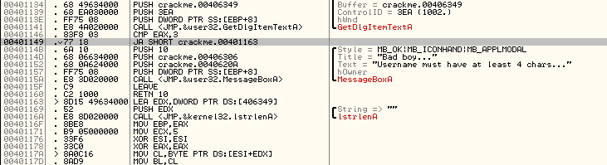
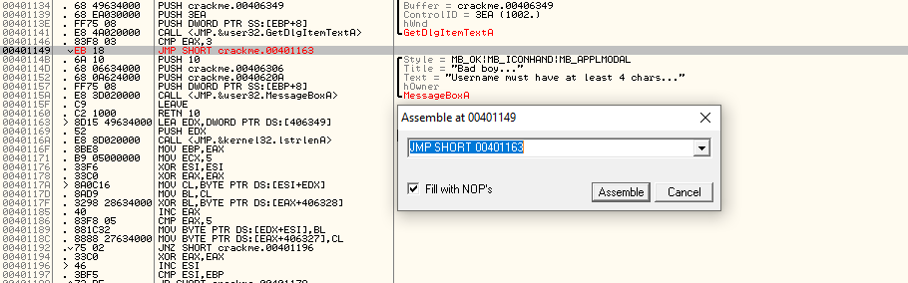

Slide 13
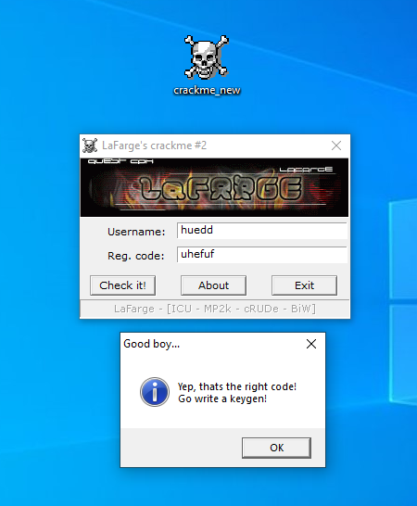
CRACKED SUCCESSFULLY

Slide 14
Contribution and Impact of Software Cracking on People's Life.
People always like freebies
So with the help of software cracking we can use any paid software for free.
Do you remember that time, when we use to buy the cracked copy of windows 7 etc. from the market for very cheap?
We used to share that copy to our friends.
Technically using the same windows copy on multiple system that is only possible with software cracking.
With the help of software cracking now people don't have to worry about their paid verisons and they can do their daily task tension free.
Infact now a days cracked softwares also contain some sort of modification which ultimately ease our task than the original one.

Slide 15
THANK YOU !

